Slide 1

Summer Intern Hackathon 2019
Finding Meaning in the Data
Tyler Swensen
Daniel Rutledge

Slide 2
“Much of what we do with machine learning happens beneath the surface. Machine learning drives our algorithms for demand forecasting, product search ranking, product and deals recommendations, merchandising placements, fraud detection, translations, and much more. Though less visible, much of the impact of machine learning will be of this type — quietly but meaningfully improving core operations.”
Jeff Bezos
Some Guy at Amazon

Slide 3
The Future of Pricing
Pros customers have tons of data
AI is really good at solving Pros problems
AI is accessible
Pros is the bleeding edge of applying AI to these business problems

Slide 4
Develop a prototype of a solution for a customer need, that uses AI to find meaning in the data.

Slide 5
Dataset – Sales Transactions
Region | Country | Item Type | Sales Channel | Order Priority | Order Date | Order ID | Ship Date | Units Sold | Unit Price | Unit Cost | Total Revenue | Total Cost | Total Profit
Sub-Saharan Africa | Togo | Baby Food | Offline | H | 1/2/2010 | 9.42E+08 | 1/15/2010 | 3449 | 255.28 | 159.42 | 880460.7 | 549839.6 | 330621.1
Sub-Saharan Africa | Madagascar | Household | Offline | C | 1/7/2010 | 1.95E+08 | 2/12/2010 | 5276 | 668.27 | 502.54 | 3525793 | 2651401 | 874391.5
Sub-Saharan Africa | Zimbabwe | Meat | Online | C | 1/9/2010 | 4.05E+08 | 1/25/2010 | 8430 | 421.89 | 364.69 | 3556533 | 3074337 | 482196
Middle East and North Africa | Oman | Cosmetics | Online | C | 1/10/2010 | 9.39E+08 | 2/17/2010 | 8870 | 437.2 | 263.33 | 3877964 | 2335737 | 1542227

Slide 6
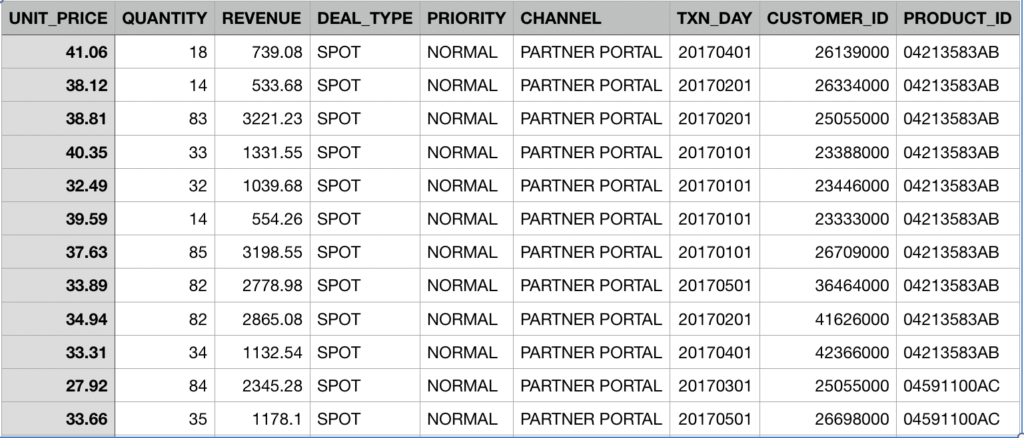
Dataset - Guidance

Slide 7

Tools
Azure Machine Learning Studio
R and Python support
Azure Storage, relational or non-relational data sources
Preprocess datasets
Build and train models

Slide 8
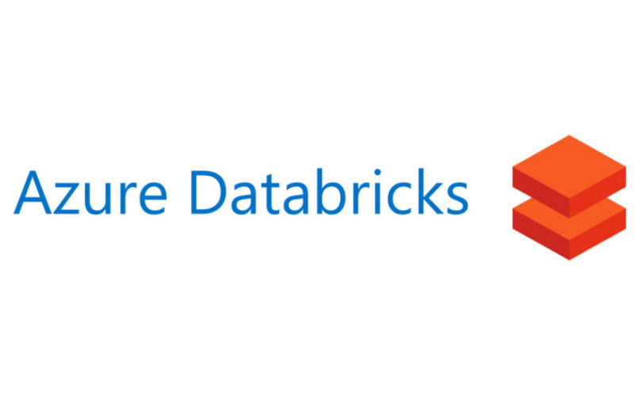
Tools
Azure Databricks
Can code in SQL, Python & Scala
Collaborative
Easy to setup UI inputs
Designed for Machine Learning
Drag and drop database setup

Slide 9
Scoring Rubric – Innovation (5 Points)
(1) The chosen solution is already established. No innovative use of technology.
(2) The solution adds a new twist on an established implementation. (e.g. uses a new library or tool)
(3) The project adds a major departure from established implementations. (e.g. leverages a new framework or middleware)
(4) The project makes a profound break from established design (e.g. uses a new language or emerging technology in way previously not used)
(5) The implementation and design and completely new with no precedent.

Slide 10
Scoring Rubric – Quality of Implementation (10 Points)
(1) The team was unable to produce a functioning prototype.
(5) The team produced a partially functional prototype.
(10) The prototype is fully functional and showcases all the features of the solution design.

Slide 11
Scoring Rubric – Impact (5 Points)
(1) The solution provides little or no benefit to the user and has no supporting evidence of market viability.
(2) The solution provides little benefit to the user but has some supporting evidence of market viability
(3) The solution provides some benefit to the user but has little supporting evidence of market viability.
(4) The solution provides some benefit to the use and has supporting evidence of market viability.
(5) The solution provides a marked advantage to the user and has supporting evidence of market viability

Slide 12
Scoring Rubric – Presentation (5 Points)
(1) The visualizations and demonstration obscured the functionality and the intended function was unclear.
(2) The visualizations and demonstration obscured the functionality and the intended function was poorly explained.
(3) The visualizations and demonstration were difficult to understand, and the functionality was poorly described.
(4) The visualizations and demonstration were clear, but the functionality was poorly explained.
(5) The visualizations and demonstration were clear, and the functionality was well explained.

